Slide 1
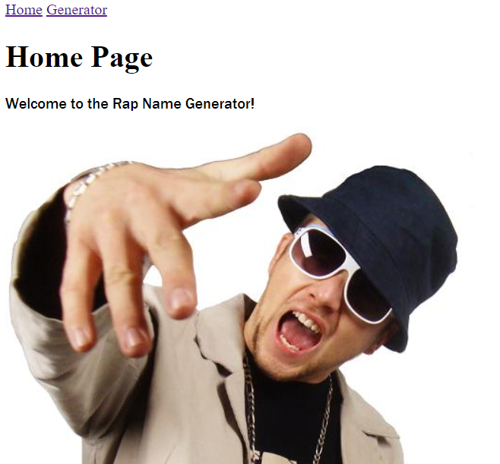
The Rap Name Generator
By Liam Mather

Slide 2
The Contents
The Concept
The Design and Documentation
The Development
The Testing
The Demonstration
The Summary
The END

Slide 3
The Concept
I set out to create an app running with 4 separate services.
This service is the frontend of the application - also allows for user input
This service will randomly select a word from a list
This service will also randomly select a word from a list
This service will add the user input and both services together to create a rap name then post it to the frontend

Slide 4

The Design and Documentation
Trello Board
Risk Analysis
Use Case Diagram
User Stories

Slide 5

The Development
Python - Flask
Google Cloud Computing

Slide 6
The Tools I Used
GCP
Git
HTML
Jenkins
Ansible
Docker
Nginx

Slide 7

The Demonstration
http://35.246.85.105/

Slide 8
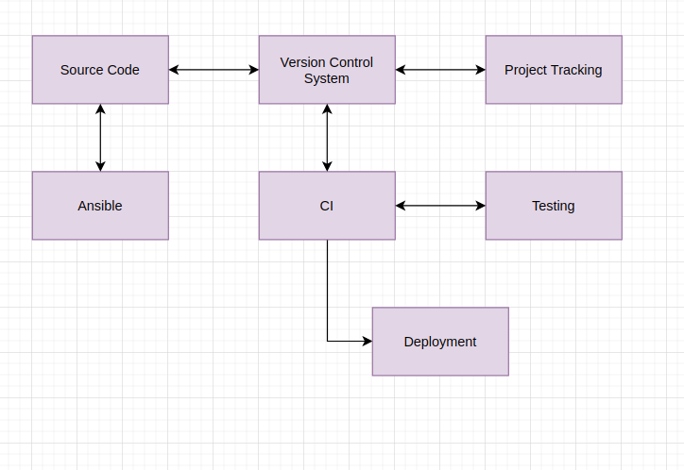
The Pipeline

Slide 9







The Pipeline

Slide 10
The Summary
In this project i have learned to use professional DevOps tools to design, develop and deploy an application with multiple services.

Slide 11
The END
Thank you for your time!

